Slide 1
DWDM
Unit 2

Slide 2
Layers within DW architecture
Data Source Layer
Internal and external data sources
Staging Layer
A temporary area where data transformations is carried out (may be absent if it is performed in data storage layer)
Data Storage Layer
Consists of data warehouse database and data marts

Slide 3
Approaches to building DW
Focuses on the data storage layer
There are two approaches
Inmon’s approach
Kimball’s approach

Slide 4
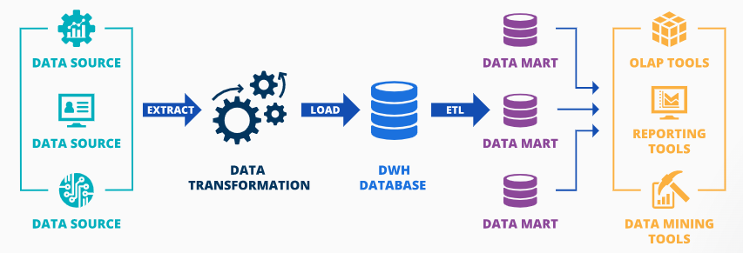
Inmon’s approach to building DW

Slide 5
Pros and Cons of Inmon’s approach
Pros
Solid foundation for company-wide business Intelligence and data consistency across data marts.
Cons
High initial costs and considerable time to build.

Slide 6
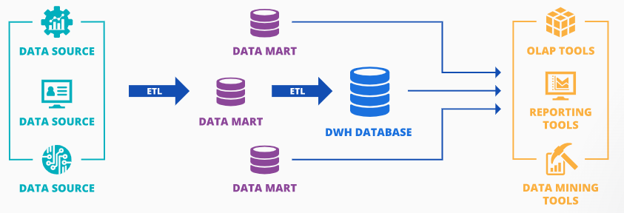
Kimball’s approach to building DW

Slide 7
Pros and Cons of Kimball’s approach
Pros
Quick time-to-insight, facilitated analytics and reporting for individual business lines/teams.
Cons
Possibility of redundant data and lack of data consistency in data marts as they are developed autonomously.

Slide 8
Populating DW
It is an ongoing process
Initial load + Periodic incremental loads
Full refresh may be required due to schema change
Facts table need more frequent updating than dimension table
Eg. Db2, Apache Airflow, Apache Kafka, SQL, Python

Slide 9
Process of populating DW
Choosing of appropriate extraction method
Making the extracted data available for further processing

Slide 10
Extraction Methods
Full Extraction
All the data is extracted completely from the source system since the last successful extraction
It does not require keeping track of changes in the source file
Mostly used for tables that will be used as dimensions table in a cube

Slide 11
Extraction Methods (contd…)
Incremental Extraction
Only specific data that has changed from a specific time in history will be extracted
It requires keeping track of changes in the source file
Mostly used for tables that will be used as facts table in a cube

Slide 12
Extraction Methods (contd…)
Full Extraction and Incremental Extraction can be online or offline
Online
Direct access to source system
Offline
No direct access to source system

Slide 13
Techniques for Tracking changes
Change Data Capture (CDC)
It keeps log for every INSERTs, UPDATEs, and DELETEs on SQL Server tables
It keeps records of what changed, where and when
This log is then used as an input
Only available in Enterprise edition of SQL Server 2008 or later

Slide 14
Techniques for Tracking changes (contd…)
Timestamps
It specifies the time and date that a given row was last modified
It makes easy to identify the latest data
Partitioning
Implements range partitioning such that the source tables are partitioned along a date key

Slide 15
Techniques for Tracking changes (contd…)
Database triggers
Triggers are added for INSERT, UPDATE AND DELETE

Slide 16
Techniques for Tracking changes (contd…)
MERGE Statement
Extracting and entire table from source system and compare these tables with a previous extract from the source system to identify the changed data
All the fields of source need to be checked with the destination.
Or Hash functions like MD₅ can be used as well.

Slide 17
Unlocking the data assets to the end users
Step 1
Eliminate data silos
Step 2
Prioritize unified data access, security, and governance
Step 3
Implement the right tools to analyze the data
Step 4
Unlock new data with ML integration

Slide 18
Step 1
liberate data from silos by moving it to a “data lake”—a central repository that allows to store all types of data in a single location at any scale.
Eg, With AWS can improve organizational decision-making by moving any amount of data into AWS Simple Cloud Storage (S3).

Slide 19
Step 2
control and visibility over the people who access data to satisfy both security and regulatory concerns.
centrally control and manage security and governance policies, enabling the safe and compliant flow of data throughout the organization.

Slide 20
Step 3
Cost, speed, and performance are top-of-mind concerns when it comes to converting data to actionable insights.
Analytics tools need to be purpose-built to quickly generate insights from data, and analytics need to be optimized to deliver the best performance.

Slide 21
Step 4
Add ML to data to improve operational efficiency, optimize existing processes, develop new products, and achieve revenue growth.
ML integration also offers personalization that can improve customer engagement and conversion by creating a personalized experience for customers or end users.

Slide 22
Challenges for data unlocking
Large amounts of data
Siloed data storage
Multiple formats
Governance concerns
Delayed time to insights
Times and expense

